Slide 1

Predictive Analytics for Online Retail Sales Trends?
PROJECT BY:
SRI NIKITA DESETTY
TRILOK DHANEKULA
HEMANTH KUMAR KOTHAPALLI

Slide 2
01
02
03
Introduction
Research Question
Exploratory Data Analysis
TABLE OF CONTENTS
04
05
06
Data Mining Models
Conclusion
Appendix

Slide 3

01
Introduction

Slide 4

INTRODUCTION
In today's competitive market landscape, businesses must excel in managing sales, inventory, and overall operations. Our project leverages advanced data mining techniques to delve into sales trends, forecast future demands, and enhance operational efficiencies. By understanding the dynamics of sales and minimizing product returns, we aim to boost customer satisfaction and streamline business processes. This presentation will explore key relationships within a comprehensive dataset to tackle these pressing business challenges effectively.

Slide 5

Purpose: Overview of why managing sales, inventory, and operations effectively is crucial for competitive advantage.
Goals: To analyze sales trends, forecast future sales, optimize processes, and minimize product returns using data-driven insights.

Slide 6
02
Research question

Slide 7

Research Question
Main Question: What are all the factors that influence sales across products, geographical areas, and time periods?
Objectives:
Analyze sales patterns to gain insights into customer engagement.
Uncover consumer preferences and purchasing behaviors.
Explore geographical variations in sales to identify market opportunities.
Use predictive analytics to support strategic business decisions.

Slide 8
Data Dictionary
Variable | Type | Description
InvoiceNo | Categorical | A 6-digit integral number uniquely assigned to each transaction. If this code starts with letter ‘C’, it indicates cancellation.
StockCode | Categorical | A 5-digit integral number uniquely assigned to each distinct product
Description | Categorical | Product name
Quantity | Integer | The quantities of each product(item) per transaction
InvoiceDate | Date | The day and time when each transaction was generated
UnitPrice | Continuous | Product price per unit
CustomerID | Categorical | A 5-digit integral number uniquely assigned to each customer
Country | Categorical | The name of the country where each customer resides

Slide 9
Data Gathering and Preprocessing
Dataset
Handling Data
The dataset contains 541,909 variables across 8 variables.
The dataset has 136,534 missing values. After removal of the missing values, there are a total of 406,829 values across 8 variables. Handeled outliers.

Slide 10
Exploratory Data Analysis
03

Slide 11
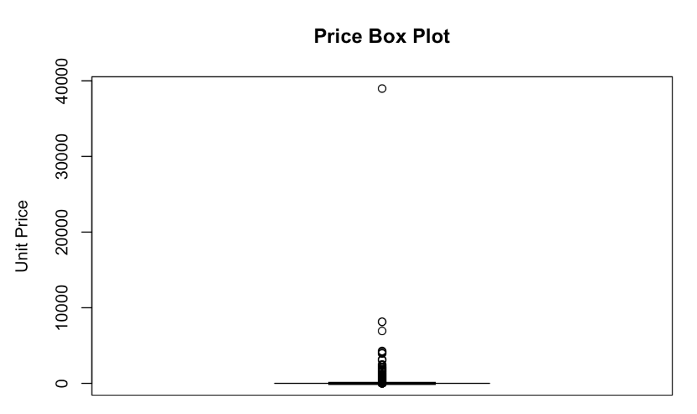
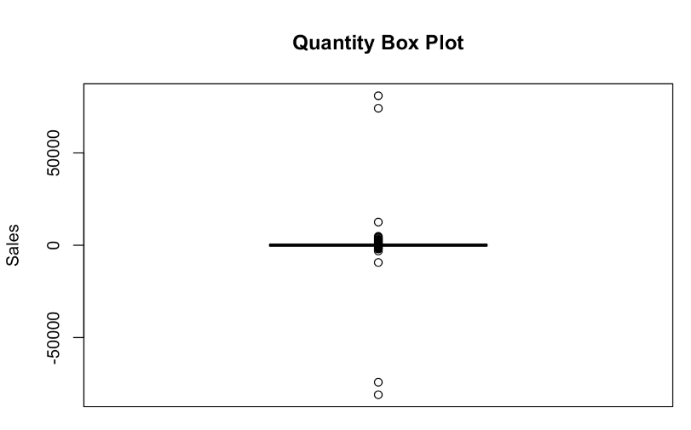
Before handling outliers

Slide 12
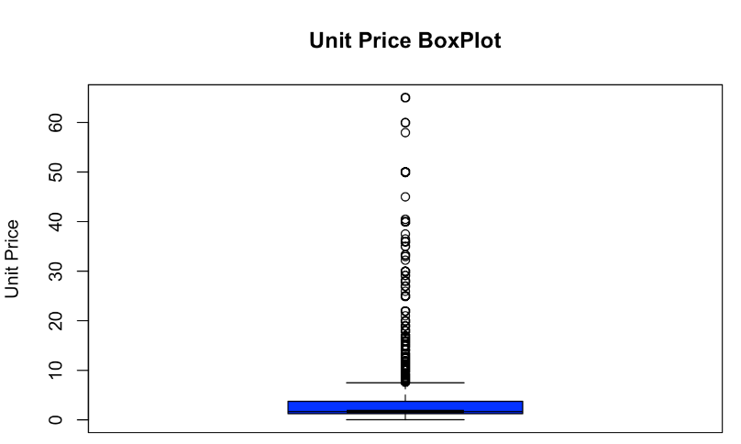
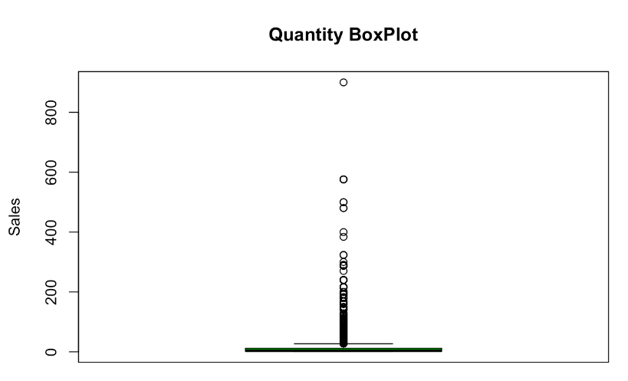
After handling outliers

Slide 13
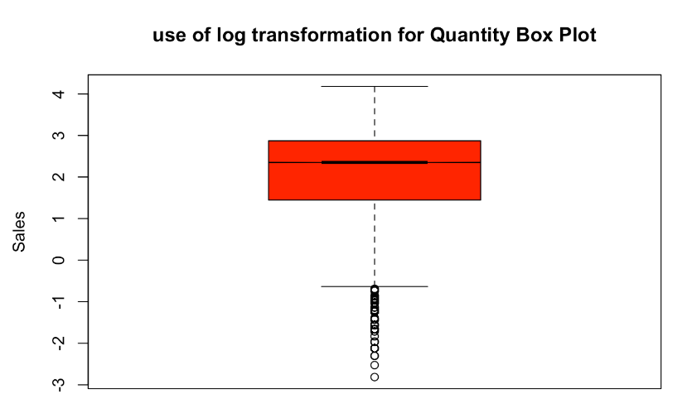
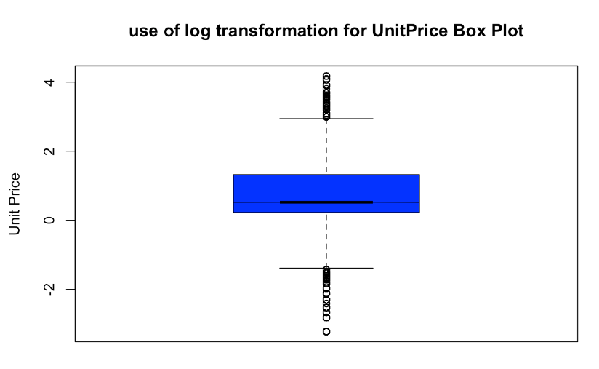
Applying log transfromation

Slide 14
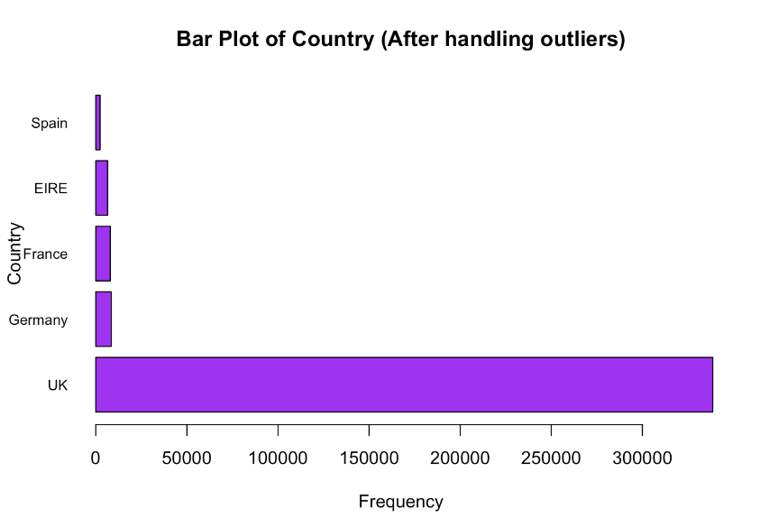
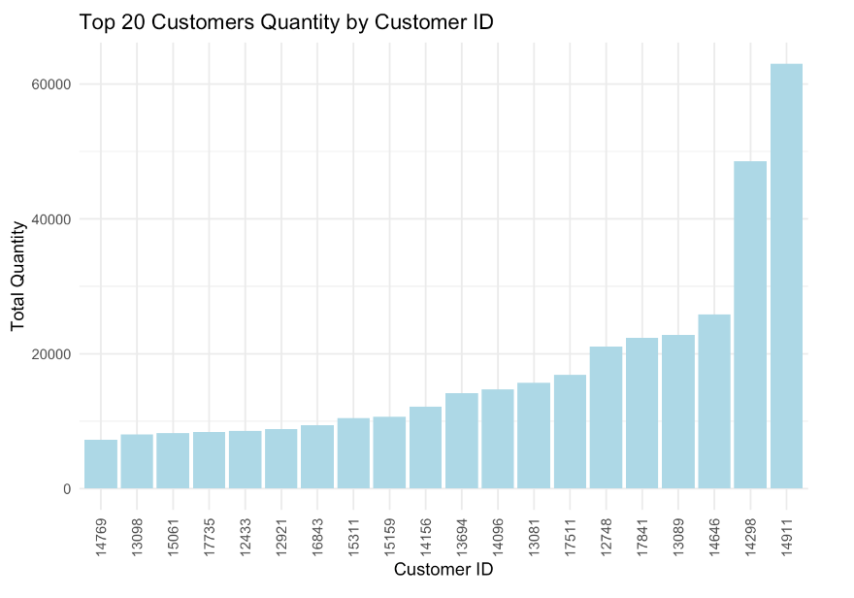
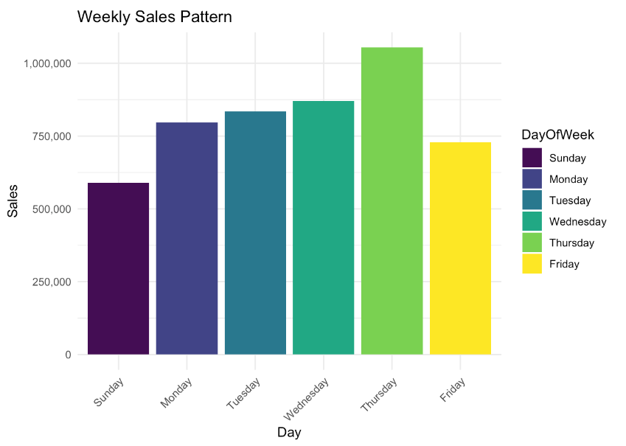
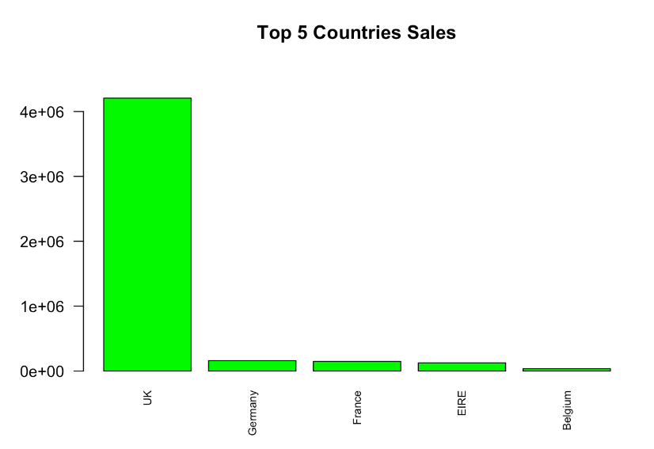
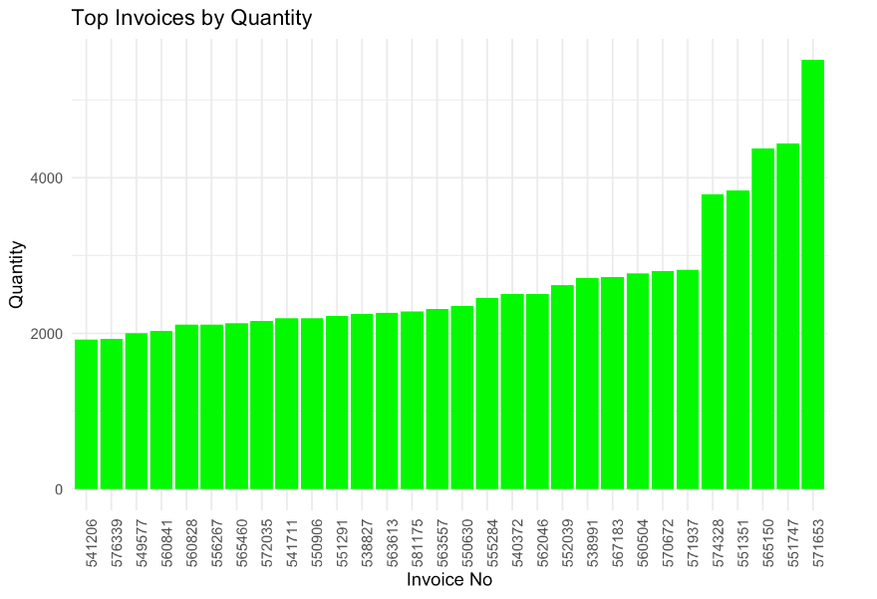
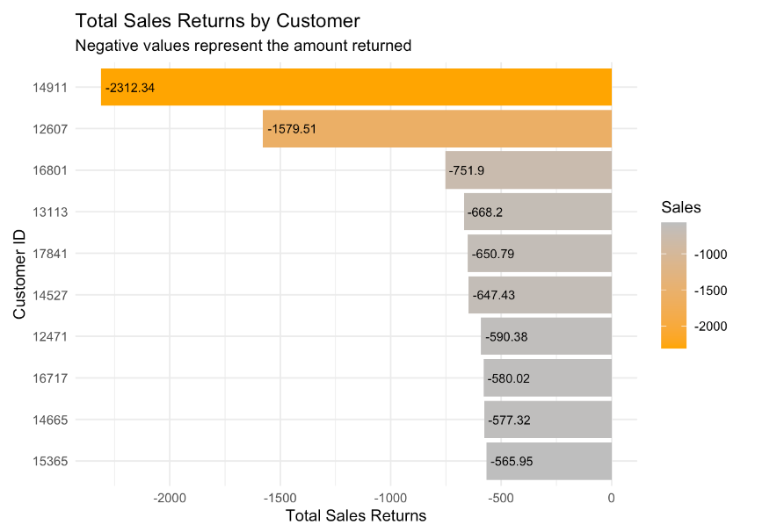

Slide 15
Data Mining Models
04

Slide 16
Data Mining Models Perfromed and Comparison
Model | Multiple Linear Regression | Decision Tree | Random Forest
RMSE | 0.4054 | 0.1651 | 0.1411
Accuracy | 0.5946 | 0.8349 | 0.8589

Slide 17
Conclusion
05

Slide 18
CONCLUSION
Multiple Linear Regression
Based on the RMSE ( Root Mean Square Error ) compared across all the three models, we can conclude that the Random Forest model fits the best.
Decision Tree
Best model Fit
Random Forest

Slide 19
Appendix
06

Slide 20
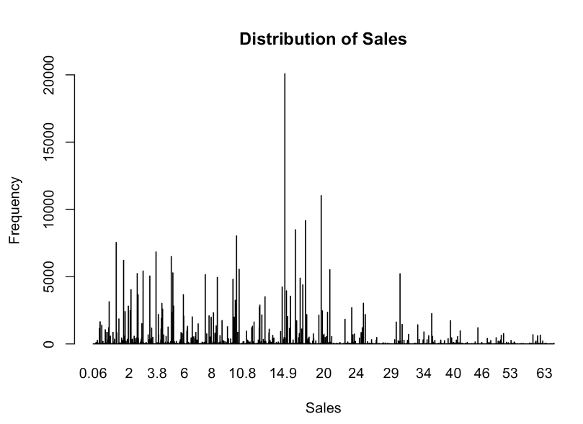
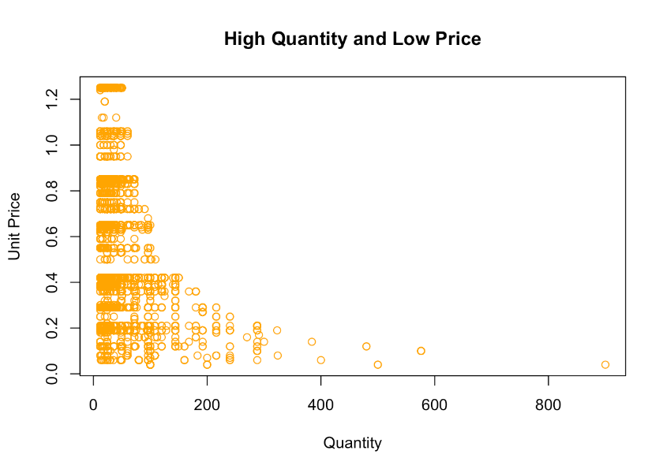
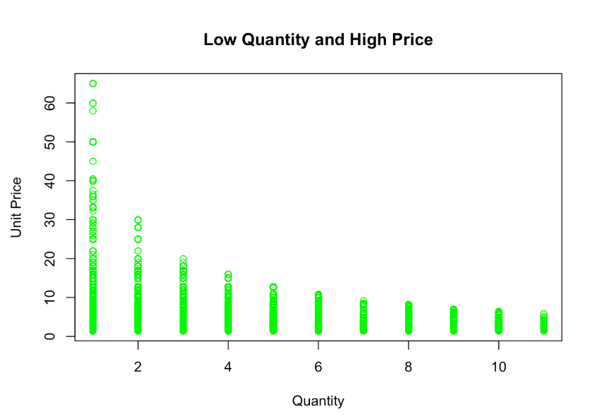

Slide 21
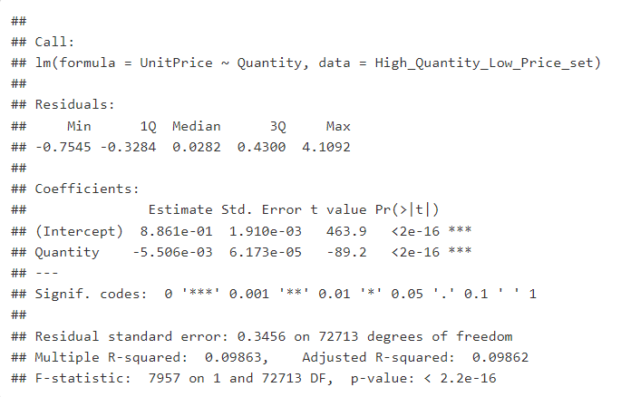
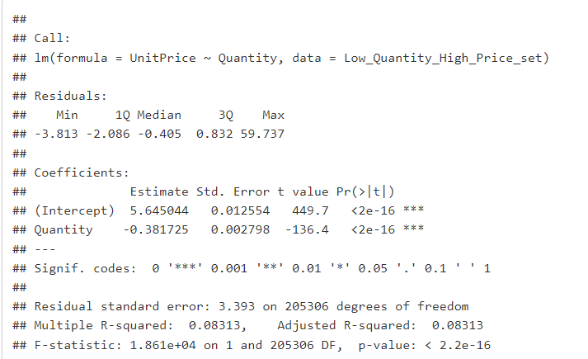

Slide 22
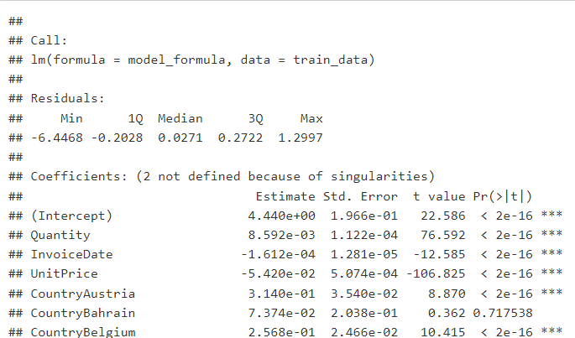
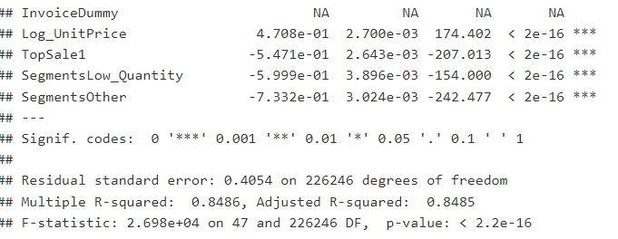

Slide 23
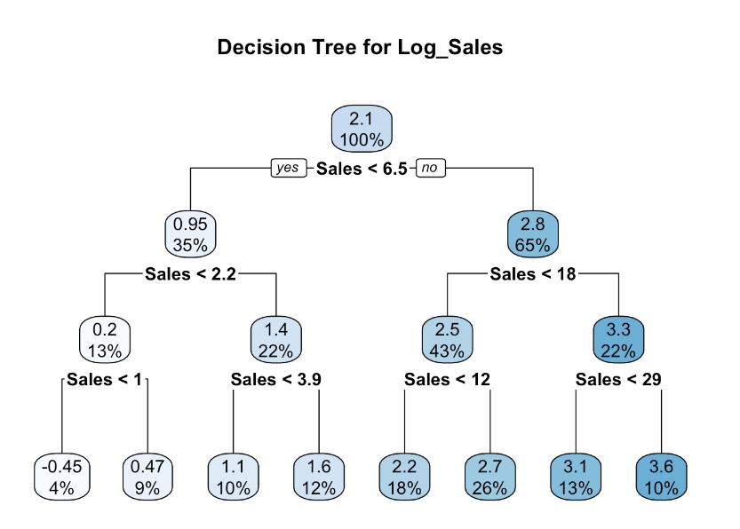


Slide 24

